Slide 1


ON
ONLINE QUIZ
Department of Information Technology
Presented by Batch number:- 16
Batch members:
K.NARASIMHA SAI (17121A1246)
K.SUSHMA (17121A1247)
K.CHANDANA (17121A1248)
Dept.of Information Technology

Slide 2

✓Abstract...............................
✓Introduction.........................
✓project Details.....................
✓Required components.........
✓Design of project.................
✓Result...................................
✓Conclusion...........................
✓Future reference..................
✓Member's roles in project....
✓Status of project..................
✓Reference to project............
Dept.of Information Technology

Slide 3

Main objective:
•To efficiently evaluate the candidate thoroughly through a fully automated system that not only saves lot of time but also gives fast results.
•By using the concepts of Functions,Files,Structures,File Handlings...this will be done..
•This results in getting the
-Easy results
-No use of pen and paper
-Fully automated system
Dept.of Information Technology

Slide 4

In this project, we store the questions, choices and correct answer into a file.
System asks the user to enter name and also asks the user whether they want to participate in the quiz or not.
If user want to participate it display the questions followed by choice and asks user to enter they choice..
Dept.of Information Technology
1

Slide 5

If the entered choice matches the correct answer..then score incremented by 10 or else it's displays choice entered is wrong.. and displays correct answer..
At the end, Displays the student total score..
Dept.of Information Technology
2

Slide 6

There are three modules:
1.Registration
2.Participate in QUIZ
3.Display Records
Dept.of Information Technology
3

Slide 7

•To register their (his/her) details to participate in the quiz.
•concepts used in it is looping statements, structures
•Details are
--Participant name.
--Participant ID no.
--Participant password.
Dept.of Information Technology
4

Slide 8

•To take part to play the Quiz game.
•Concepts used is Looping statements,Files, structures,File handling...
•Operations
--Registration
--GetQuetions
--StartExam
--WriteExam
Dept.of Information Technology
5

Slide 9

•To display stored records of participants.
•concepts are structures and files
•Operations are
--WatchScore
Dept.of Information Technology
6

Slide 10

•Minimum software Requirements:
->Ubuntu 14.04.5 LTS
->Linux operating system
•Minimum Hardware Requirements:
->4GB RAM,1TB Hard disk
->64-bit processor
Dept.of Information Technology
7

Slide 11
DESIGN OF PROJECT
Main menu
1
Registration
2
Participate in the QUIZ
3
Display records
Output
Dept.of Information Technology
8

Slide 12

REGISTRATION
Read
NAME
Read
ID No.
Set
Pswd
Dept.of Information Technology
9

Slide 13

PARTICIPATION
New user
Existing user
Registration
Questions display
Read CHOICE
Dept.of Information Technology
10

Slide 14

DISPLAY RECORDS
Display participants names
Display participants
ID no.
Display participants
Score
Dept.of Information Technology
11

Slide 15

Main menu
1.registration
2.display records
3.participate in quiz
4.exit
INPUT read
If input is 1-->registration
If input is 2-->display old participants results
If input is 3-->questions will display..participate in quiz
If input is 4-->exit from Quiz
Output we get is the Total marks
Dept.of Information Technology
12

Slide 16

* Participant NAME
* ID No.
* Score obtained
Dept.of Information Technology
13

Slide 17

•Final conclusion i.e., OUTPUT is
The total score obtained by the
Participants, their Names including
their ID numbers.
Dept.of Information Technology
14

Slide 18

For students they give papers according to their convenience and time and there is no need of using extra thing like paper, pen etc.
Dept.of Information Technology
15

Slide 19
Member's roles in project
NAME | ROLE
K.Narasimha Sai | Designer
K.Chandana | Developer
K.Sushma | Analyser
Dept.of Information Technology
16

Slide 20

Analysis | 100%
Design | 100%
Coding | 100%
Dept.of Information Technology
17

Slide 21

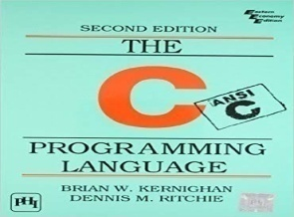
THE C PROGRAMMING LANGUAGE
*Neil Matthew and Richard Stones,
Beginning Linux
Programming, Wiley Dreamtech, Fourth Edition, 2008.
✓Software downloaded Website is
https://www.ubuntu.com/#download.
Drafted on: [02/10/2018]
Dept.of Information Technology
18

Slide 22

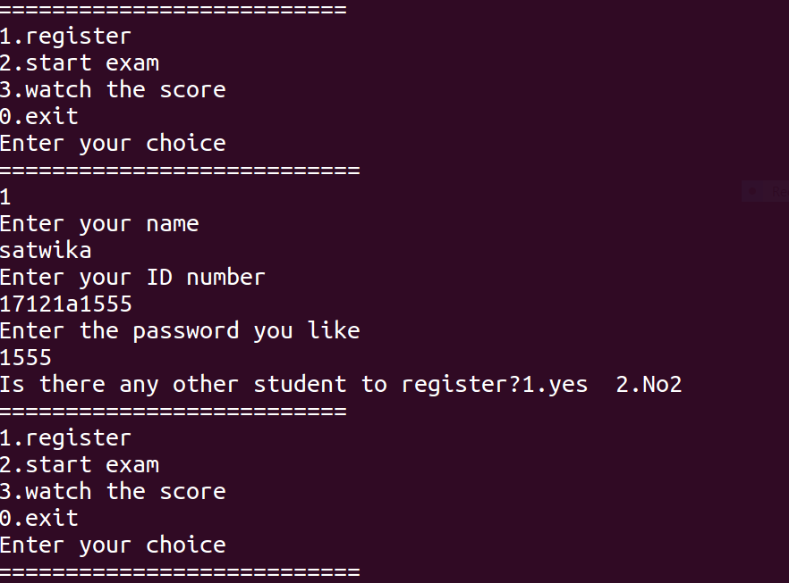
Dept.of Information Technology
19

Slide 23
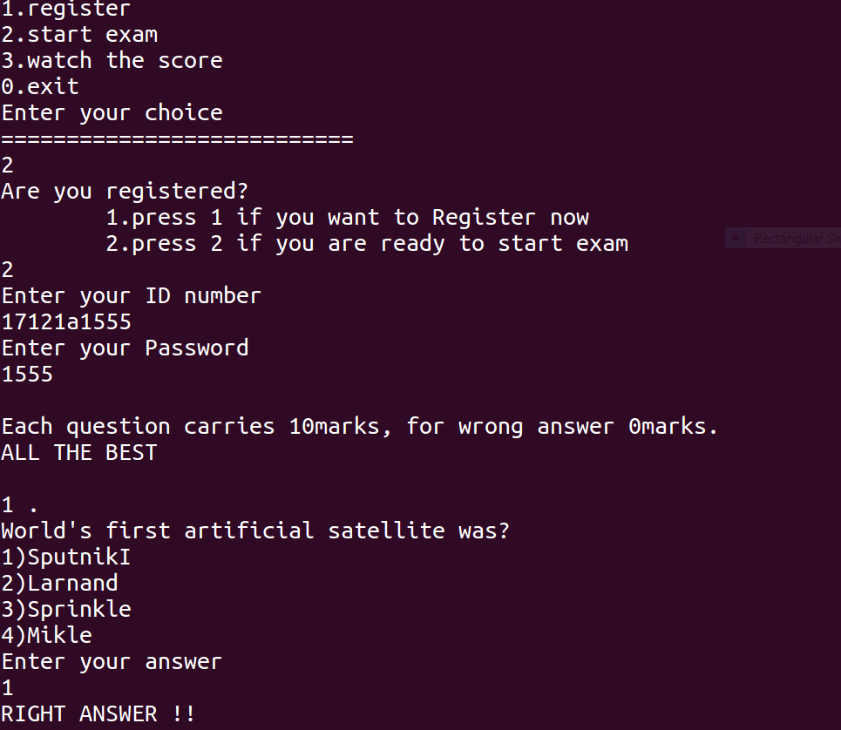
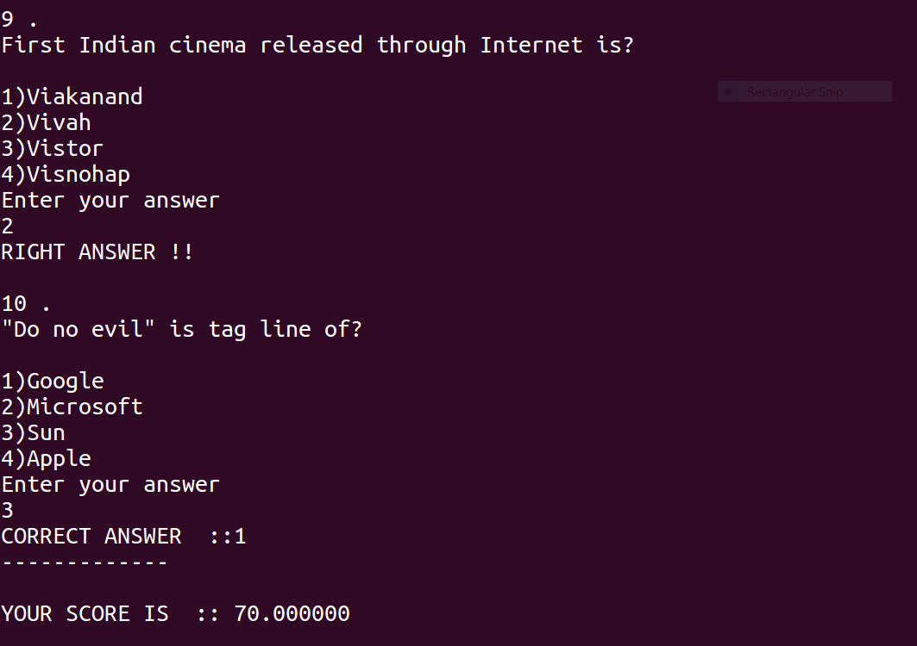
Dept.of Information Technology
20

Slide 24
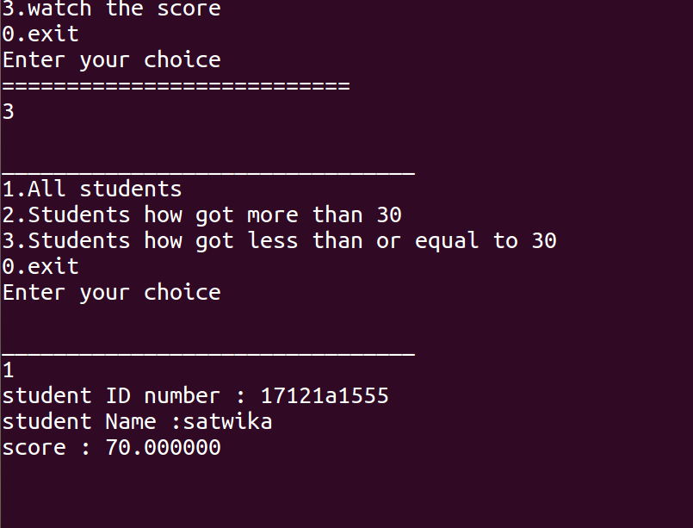
Dept.of Information Technology
21

Slide 25

Dept.of Information Technology
22

